Slide 1
CET311
Project Management
Lecture 01
Dr R L Warrender

Slide 2
Contents
Introduction to Module
Module Assessments
Further Reading

Slide 3
Introduction to Module
Educational Goals
A critical understanding of the major project management methodologies and tools together with their suitability for different project types
Appreciation of how to combine elements from each methodology/tool to produce effective solutions
The ability to develop, evaluate and assess the feasibility of project proposals, utilising appropriate tools, techniques and methods
The ability to apply appropriate methods of planning, monitoring, control and change to the various aspect of a project.

Slide 4
What you will learn
Students will be taken through the various stages of project management, learning the issues that it is important to consider during the project management life cycle:
Project selection, feasibility studies, plans and priorities.
Risk analysis and control.
Project Planning, for example network analysis, PERT, Gantt Charts, task definitions.
Project Management methodologies.
Project Monitoring and Control including cost control, quality control and review structures.
Change and Configuration management.
The human aspects of project management.

Slide 5
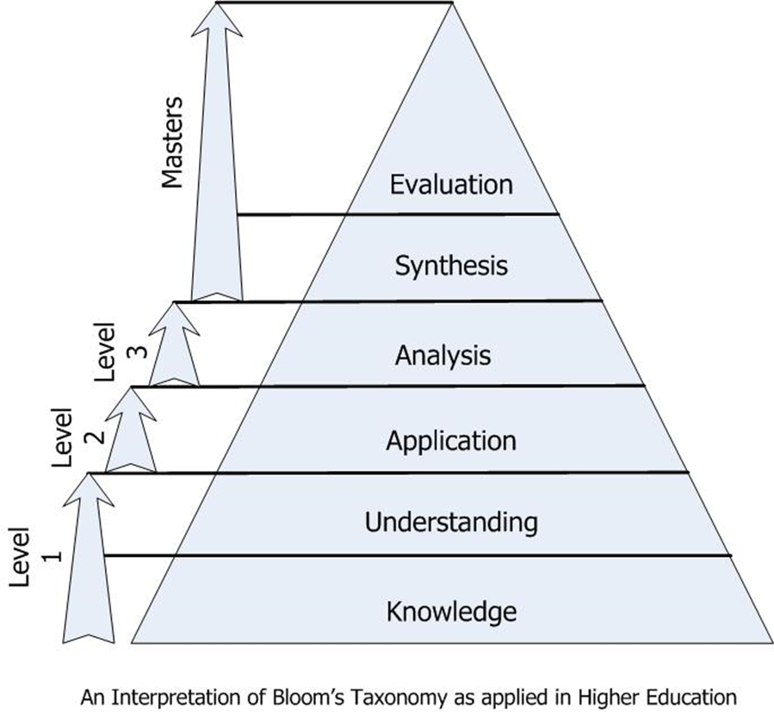
Bloom’s Taxonomy

Slide 6
Module Structure
Weekly sessions consisting of
1 hour lecture R L Warrender
2 hour lab/tutorial
Practical work enforces what you will learn in the lectures and will give you hands-on experience
Michelle (Shell) Young
Philip Irving
R L Warrender

Slide 7

Module Staff – Philip Irving
Email: Philip.irving@sunderland.ac.uk

Slide 8

Email: shell.young@sunderland.ac.uk
Module Staff – Michelle (Shell) Young

Slide 9
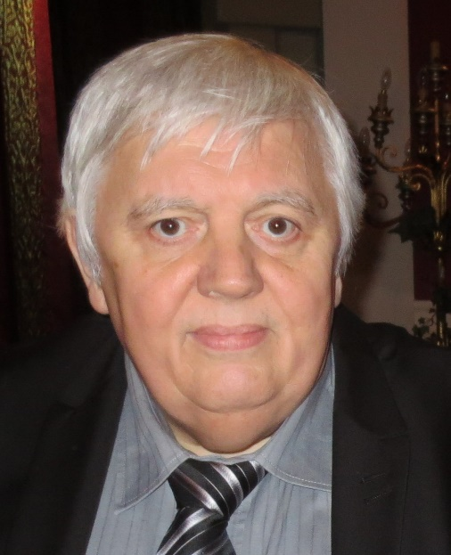
Email: robert.warrender@sunderland.ac.uk
Module Staff – R L Warrender

Slide 10
Module Structure
Lab sessions are very important to this module
We will start by spending two weeks looking at Project Management Software and an example project learning all about scheduling as well as resource management
We then move through a series of small manual exercises in order to fully understand how scheduling affects the outcome of a problem
For this we learn how to use on-arrow diagramming and precedence diagramming

Slide 11
Module Structure
At this stage we then go into an interactive case study which develops over the course of around six weeks.
We get you to organise yourselves into teams appointing typical roles as you would in a company scenario to organise how you would run a project and cope with many changes you will face week to week.
This is your chance to use much of what you will have learned in the lecture sessions to see how well your team will face in a competitive market

Slide 12
Reading Materials
Text Books
Project Management: A Managerial Approach, Jack R. Meridith and Samuel J. Mantle, Wiley
Software Project Management, Hughes, Robert and Cotterel, Michael, McGraw Hill, 5th ed.
Find Project Management text books that you are happy with

Slide 13
Extended Reading Materials
Agutter, C. (2013) Itil Lifecycle Essentials. ITGP.
Agutter. C. (2012) Itil Foundation Essentials: The Exam Facts You Need. ITGP.
Burke, R. (2013) Project Management: Planning & Control Techniques. 5th Edition. Wiley.
Cadle, J., Paul, D. and Turner, P. (2014) Business Analysis Techniques: 99 Essential Tools for Success. 2nd Edn. BCS, The Chartered Institute for IT
Carroll, J. (2012) Agile Project Management In Easy Steps. In Easy Steps Ltd.
Hinde, D. (2012) PRINCE2 Study Guide. John Wiley & Sons.
Hughes, B. (Ed) (2013) Project Management for IT-related Projects. 2nd Edition. British Informatics Society Ltd.
Hughes, R. and Cotterel, M. (2009) Software Project Management 5th edition. McGraw Hill.
Mathis, B. (2014) Prince2 for Beginners :Prince2 self-study for Certification & Project Management. CreateSpace Independent Publishing Platform.
Richards, K. (2007) Agile project management: running PRINCE2 projects with DSDM Atern. Stationery Office.
Tofts, S. (2012) PRINCE2 in Plain English. 2nd Edn. Benchmark Training and Development Limited
Tudor, D. (2010) Agile Project and Service Management: delivering IT services using ITIL, PRINCE2 and DSDM Atern. Stationery Office.

Slide 14
Assessment
A single individual assignment covering all learning outcomes, to contribute 100% of the final module mark and be submitted at the end of the module. Students produce a critical and evaluative report, utilising the concepts taught, based on the Project Management business game ‘E-solutions’

Slide 15
SunSpace
All materials are available in Sunspace
Module handbook
Weekly schedule
Lecture notes
Coursework
Tutorial exercises
Notices

Slide 16

And lastly - Questions?

